Slide 1
The Gray Market Revolution
Parallel Import Disruption in Middle East Automotive Markets
A Comprehensive Analysis of Unauthorized Vehicle Imports
and Their Impact on Traditional Distribution Channels
Industry Analysis Report | September 2025

Slide 2
Executive Summary
Middle East automotive industry valued at $112+ billion
90% of GCC vehicles sold through imports, creating parallel ecosystem
Gray market circumvents traditional profit-maximization strategies
Saudi Arabia: 600,000+ annual registrations (50% of MENA region)
Consumer savings of 20-30% driving adoption across all segments
Gray import vehicles operate legally outside manufacturers' official distribution networks while fundamentally reshaping consumer behavior, pricing strategies, and competitive dynamics across the region's largest automotive markets.

Slide 3
Market Context Import-Dependent Ecosystem
Region's overwhelming dependence on vehicle imports creates vulnerability
90% of GCC vehicles imported primarily from Japan, South Korea, China
Saudi Arabia: Toyota leads with 20.20% market share (14,570 units)
Multiple entry points enable gray market price arbitrage exploitation
Limited local production maintains import dependency conditions
The scale of importation creates multiple entry points for gray market operators who exploit price differentials between source markets and final destinations.

Slide 4
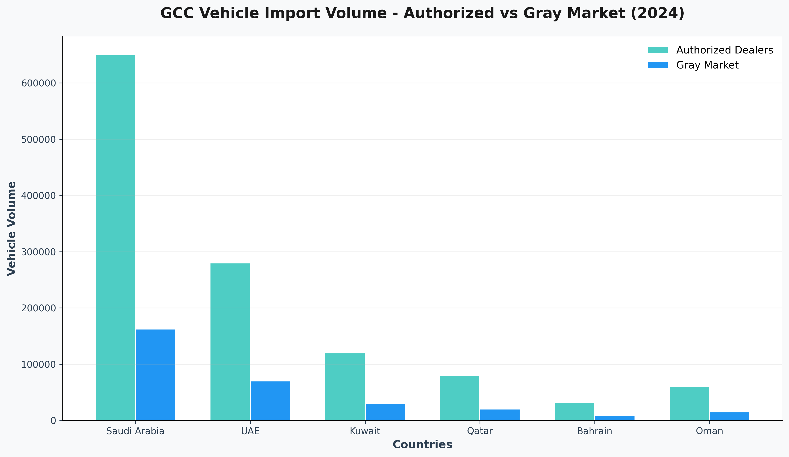
GCC Vehicle Import Volume Analysis
Saudi Arabia dominates both authorized and gray market channels, with gray market representing approximately 20% of total imports across the region.

Slide 5
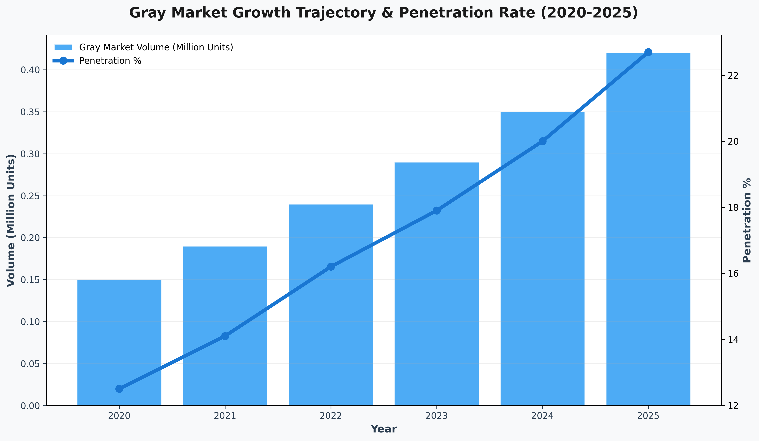
Gray Market Growth Trajectory
Gray market penetration increased from 12.5% to 22.7% over five years, with particular acceleration post-2021 coinciding with digital platform adoption and supply chain innovations.

Slide 6
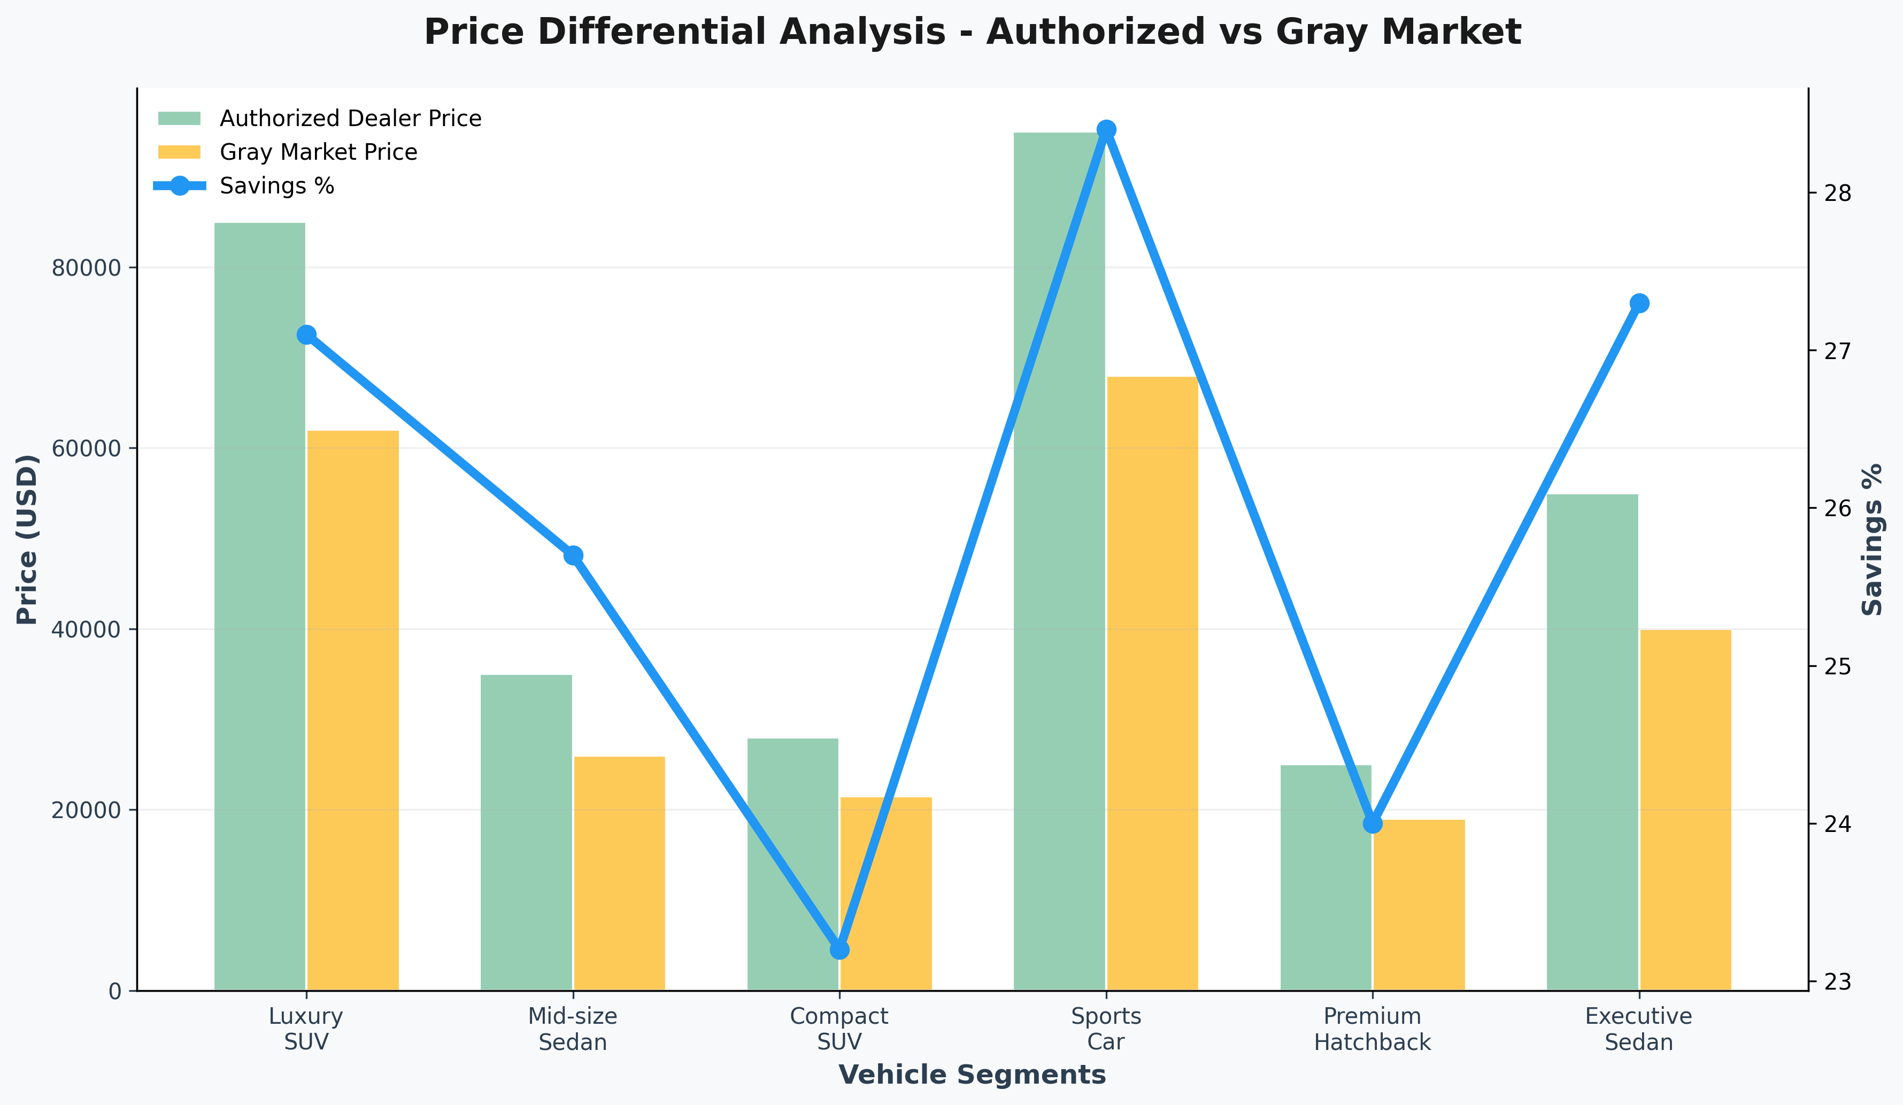
Consumer Value Proposition
Average savings range from 23.2% to 28.4% across vehicle segments. Luxury and sports car segments show the highest savings potential through currency arbitrage and market positioning differences.

Slide 7
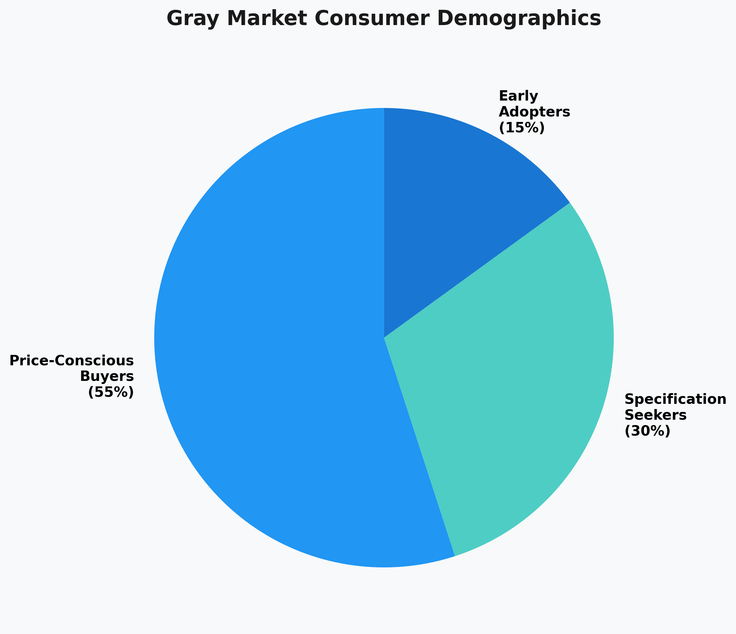
Consumer Demographics & Motivations
Price-conscious buyers represent 55% of gray market consumers, followed by specification seekers (30%) and early adopters (15%). This distribution highlights cost savings as the primary adoption driver.

Slide 8
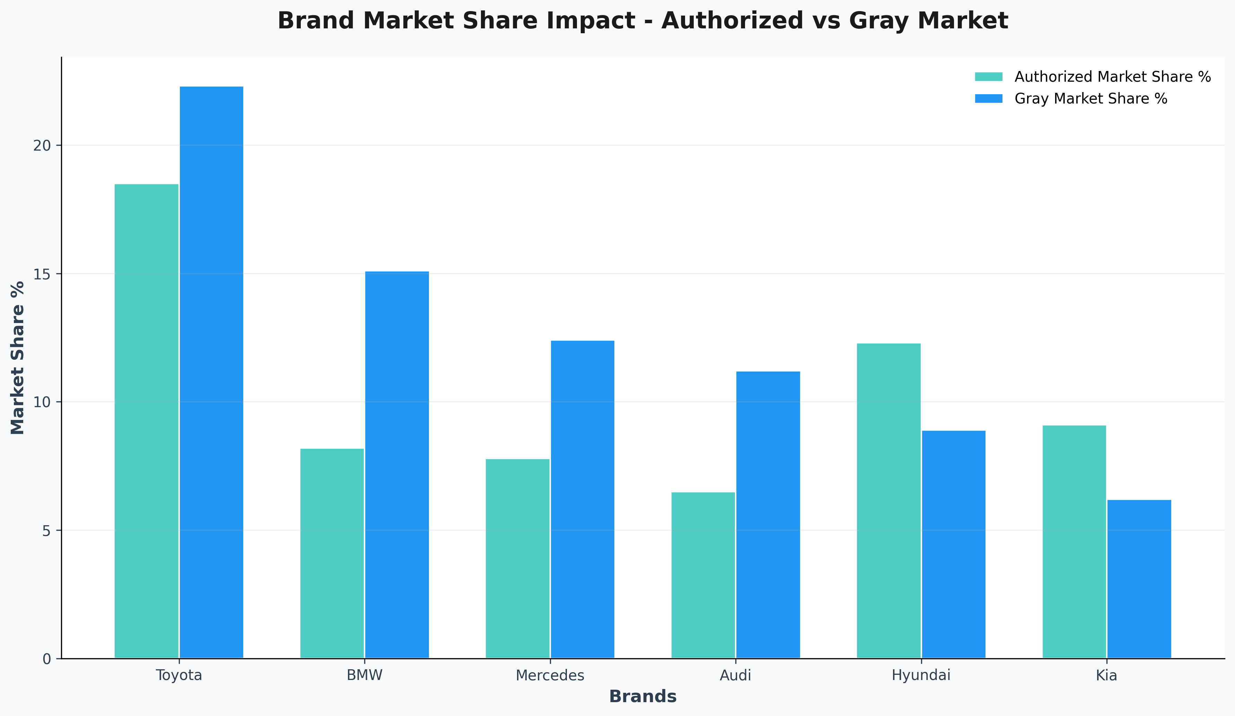
Industry Impact: Authorized Dealer Challenges
Luxury brands face the greatest challenges from gray market competition. BMW and Mercedes experience significant market share losses, with negative impact percentages indicating revenue erosion.

Slide 9
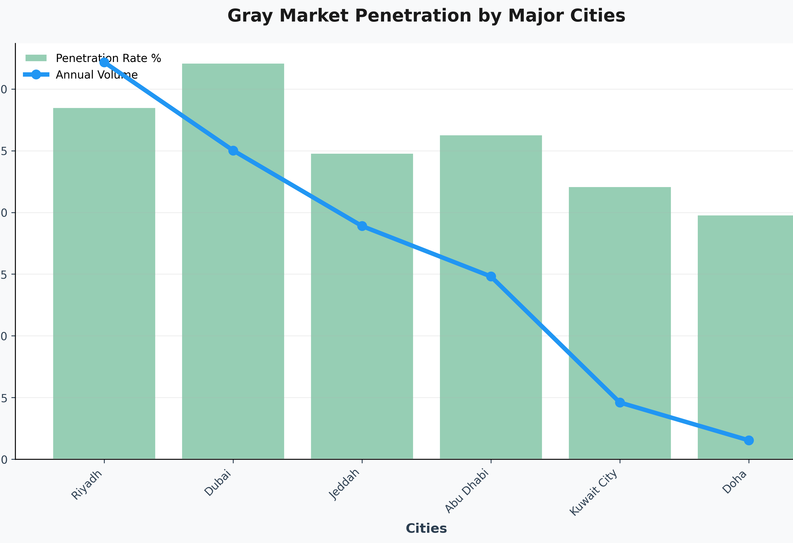
Regional Market Penetration Patterns
Dubai shows the highest gray market penetration at 32.1%, reflecting its position as a regional trading hub. The correlation between market size and penetration rates is evident across urban centers.

Slide 10
Supply Chain Evolution
GRAY MARKET SUPPLY CHAIN FLOW:
Source Markets → Import Hubs → Distribution → End Consumer
(Japan, Korea, USA) → (Dubai, Abu Dhabi) → (Local Dealers) → (20-30% Savings)
Streamlined process achieves faster delivery than traditional networks
Lower costs through optimized logistics and reduced intermediary markups
Digital platforms democratize access to gray market opportunities
Blockchain tracking provides confidence levels matching authorized dealers

Slide 11
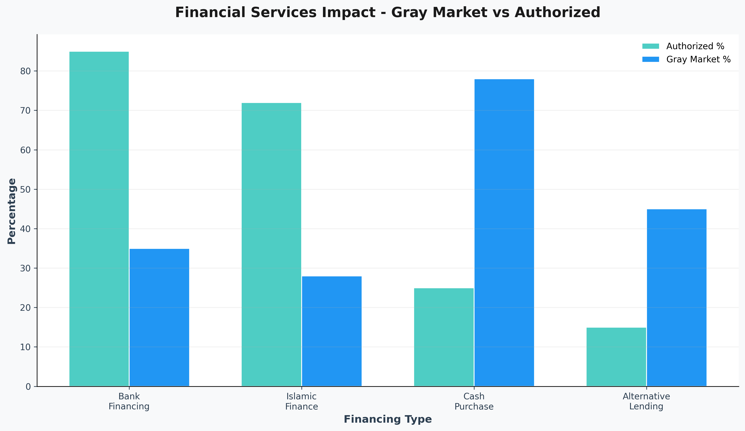
Financial Services Disruption
Financing accessibility shows significant disparities. Gray market vehicles face limited bank financing (35% vs 85% authorized), leading to cash-dominant transactions (78% of purchases).

Slide 12
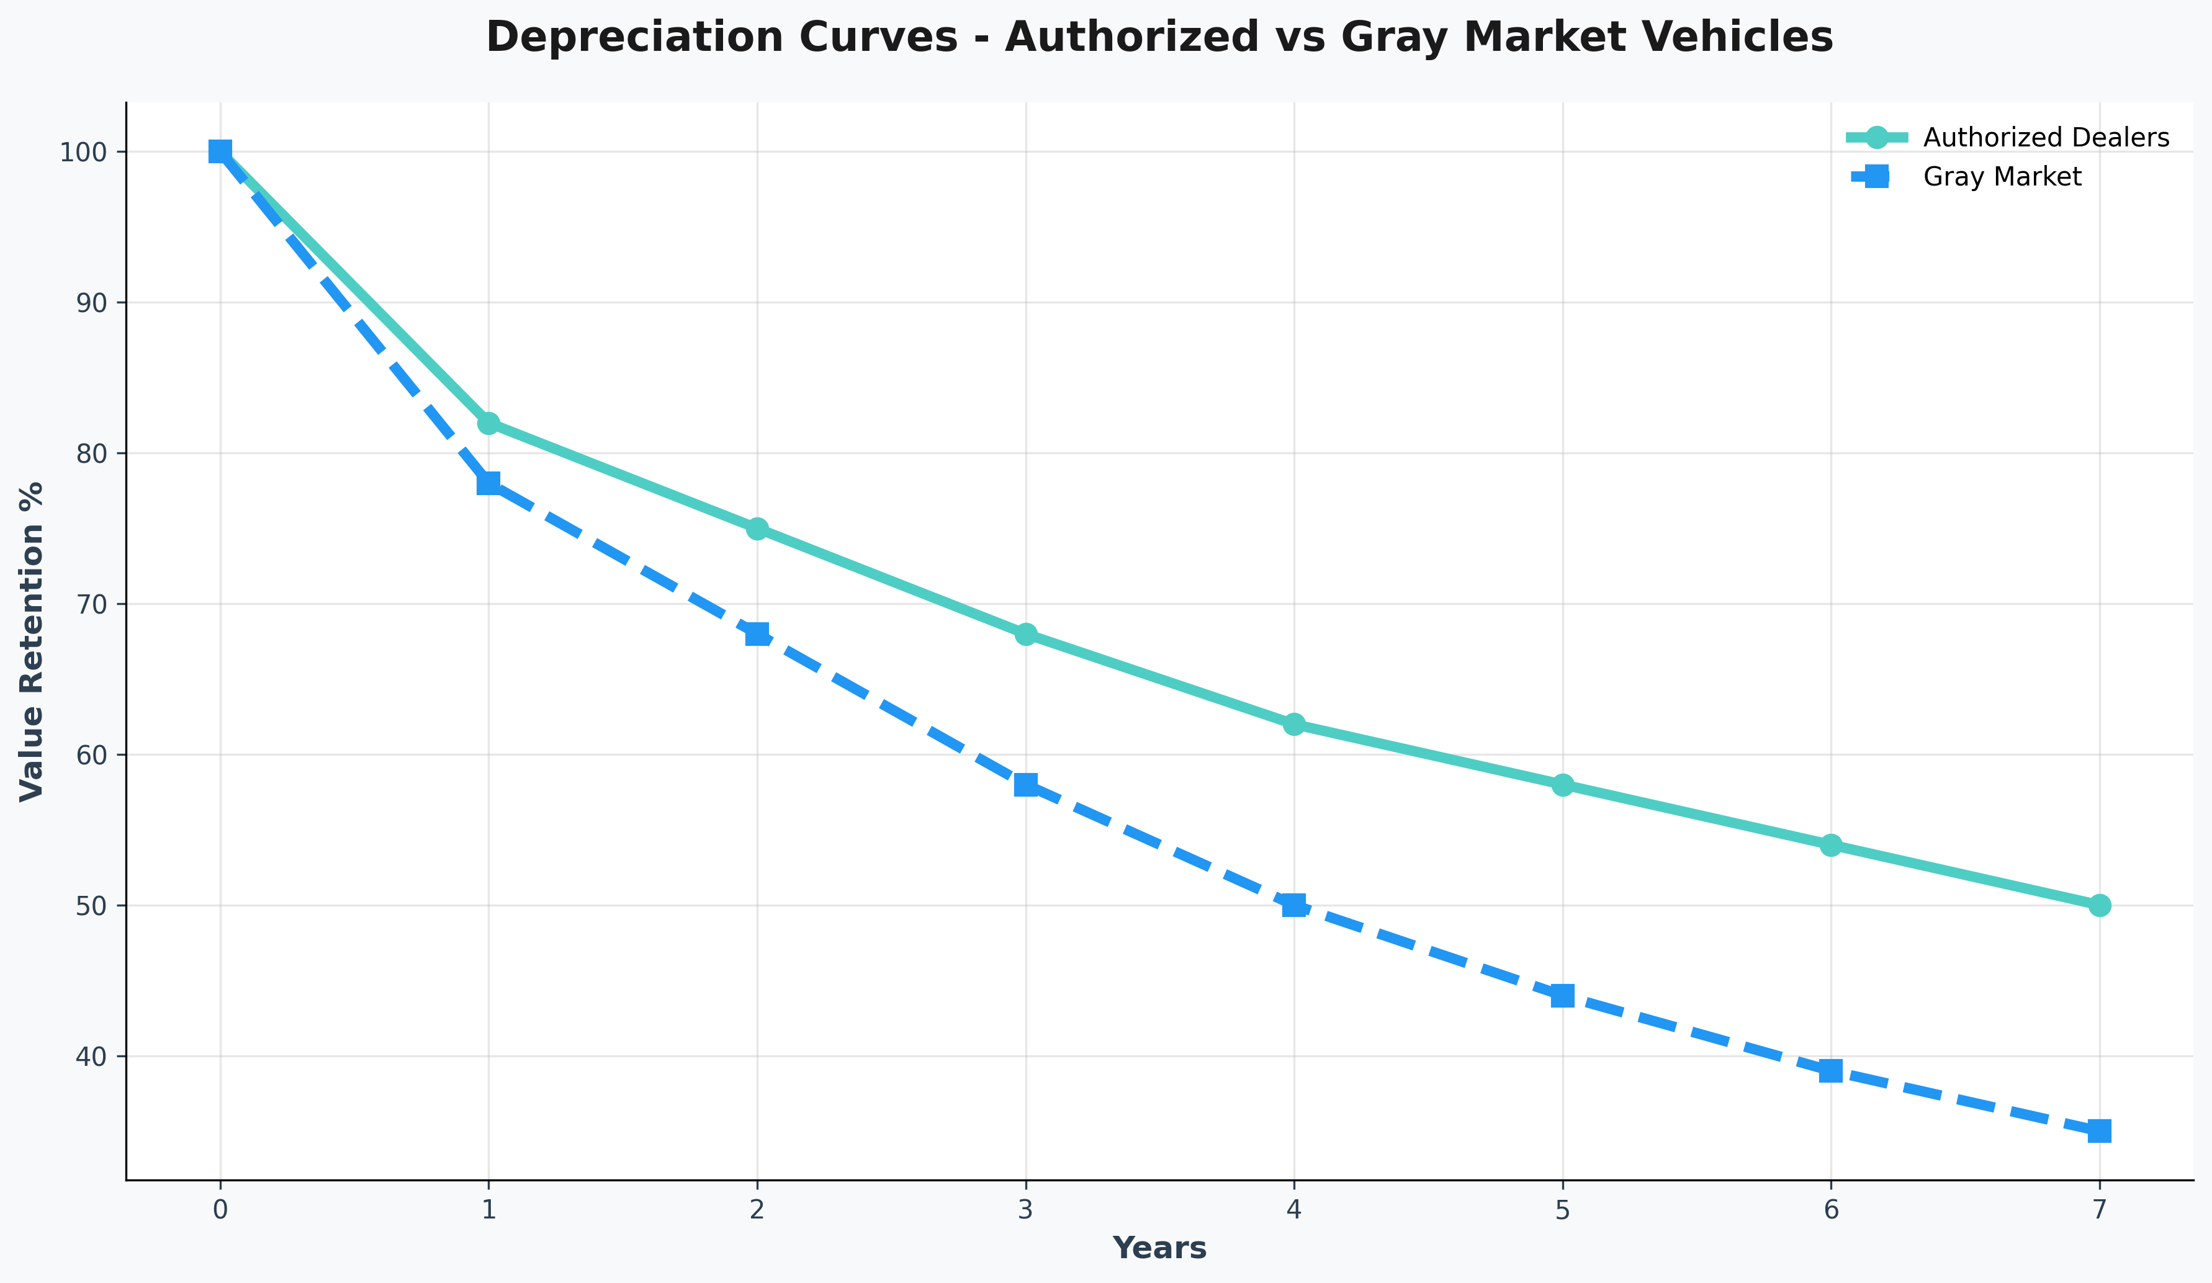
Depreciation & Resale Analysis
Gray market vehicles depreciate faster, retaining 60-70% value after three years vs 70-80% for authorized dealers. However, initial savings often offset depreciation differences for cost-focused buyers.

Slide 13
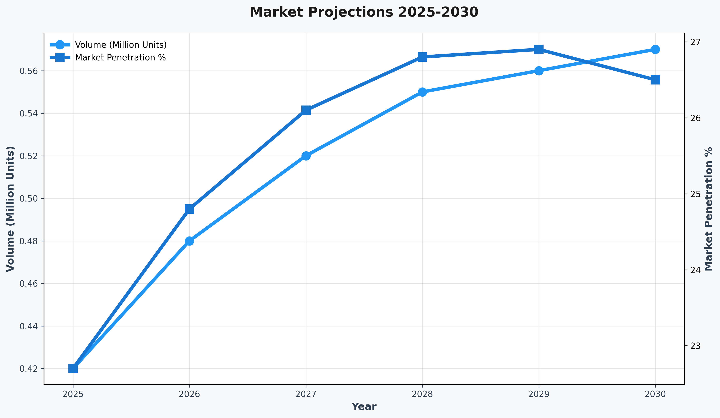
Future Market Projections
Market growth expected to stabilize around 26-27% penetration by 2030. Growth rates will moderate as regulatory frameworks evolve and manufacturers adapt competitive strategies.

Slide 14
Economic Impact Assessment
COMPREHENSIVE ECONOMIC ANALYSIS:
$1.8B Annual Revenue Loss (Authorized dealers across GCC)
$2.1B Annual Consumer Savings (Direct financial benefit)
+12% Market Efficiency Improvement (Enhanced price competition)
15,000 Employment Impact (Jobs created in gray market ecosystem)
$6-8B Total Gray Market Value (Combined GCC activity)
Net Positive Economic Impact: Consumer savings exceed dealer revenue losses, indicating improved economic welfare through enhanced market competition and price discovery mechanisms.

Slide 15
Strategic Recommendations
FOR MANUFACTURERS:
  Dynamic pricing models to minimize arbitrage opportunities
  Enhanced dealer value propositions with exclusive model variants
  Technology differentiation through proprietary systems
  Regional pricing harmonization strategies
FOR AUTHORIZED DEALERS:
  Service excellence focus with comprehensive warranty coverage
  Flexible financing solutions addressing gray market gaps
  Market segmentation targeting warranty-sensitive consumers
  Customer experience enhancement and relationship building
FOR CONSUMERS:
  Total cost analysis including warranty, insurance, and resale impacts
  Thorough due diligence on vehicle history and documentation
  Service planning for maintenance and repair accessibility

Slide 16
Key Conclusions
Gray market represents permanent $6-8B annual market force
Consumer savings of 20-30% establish parallel imports as standard option
Coexistence model between authorized and gray market channels
Success determined by channels' distinct value propositions
Continued influence on consumer choices and industry profitability
Future Outlook: As Middle East automotive market maintains 7% CAGR through 2030, gray market operations will remain transformative force shaping competitive landscape, requiring strategic adaptation from all stakeholders.

Slide 17
Thank You
Questions & Discussion
The Gray Market Revolution: Parallel Import Disruption
in Middle East Automotive Markets

