Slide 1
Oil-Rich Nations Reject Electric Cars
Why the World's Wealthiest Energy Producers Are Betting
Against Batteries and Leading the Hydrogen Hybrid Resurgence
25%
3%
31.36%
$455M
Global EV Growth
ME Penetration
Hydrogen CAGR
Market by 2031

Slide 2






Executive Summary: The Hydrogen Imperative
While global EV sales surge 25% to 17M+ units, Middle East adoption stagnates at 3% vs. 35% in China
Hydrogen fuel cell technology demonstrates 31.36% CAGR growth vs. 4.2% for battery EVs in the region
Desert climate creates fundamental battery performance constraints: 30% efficiency at 50°C+ vs. 95% for hydrogen
Infrastructure economics favor hydrogen: $70B investment vs. $115-145B for equivalent battery systems
Market opportunity: $455M hydrogen market by 2031 represents 435% growth from current $85M baseline
Strategic positioning: Early mover advantage exists for 2024-2026 foundation phase market entry

Slide 3
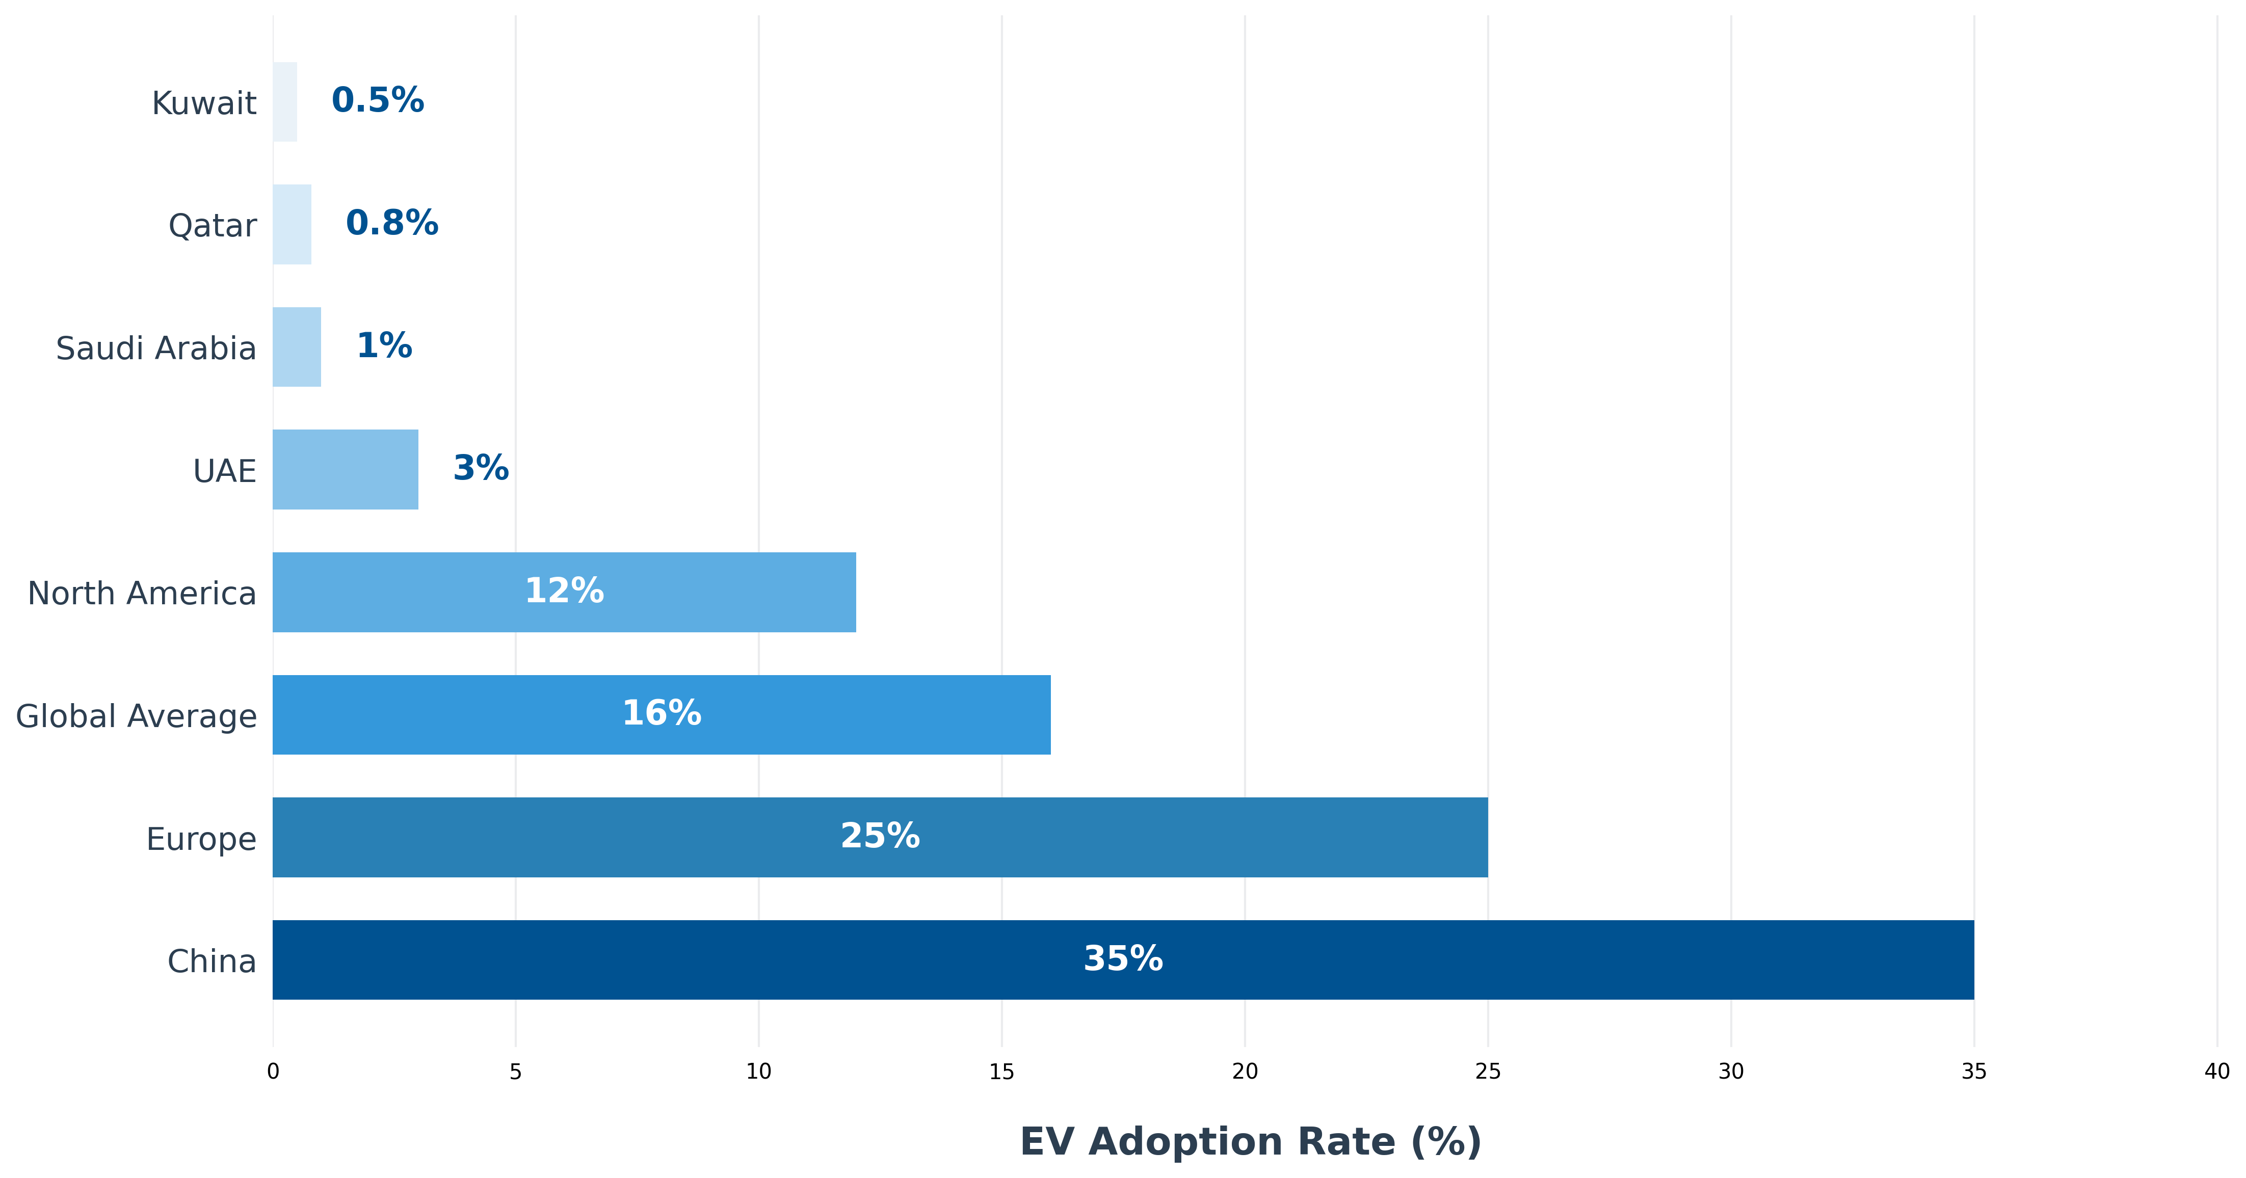
Global vs. Middle East EV Adoption Rates (2024)
Middle East adoption lags 5-10x behind global leaders
Source: Roland Berger (2024), IEA Global EV Outlook (2025)

Slide 4
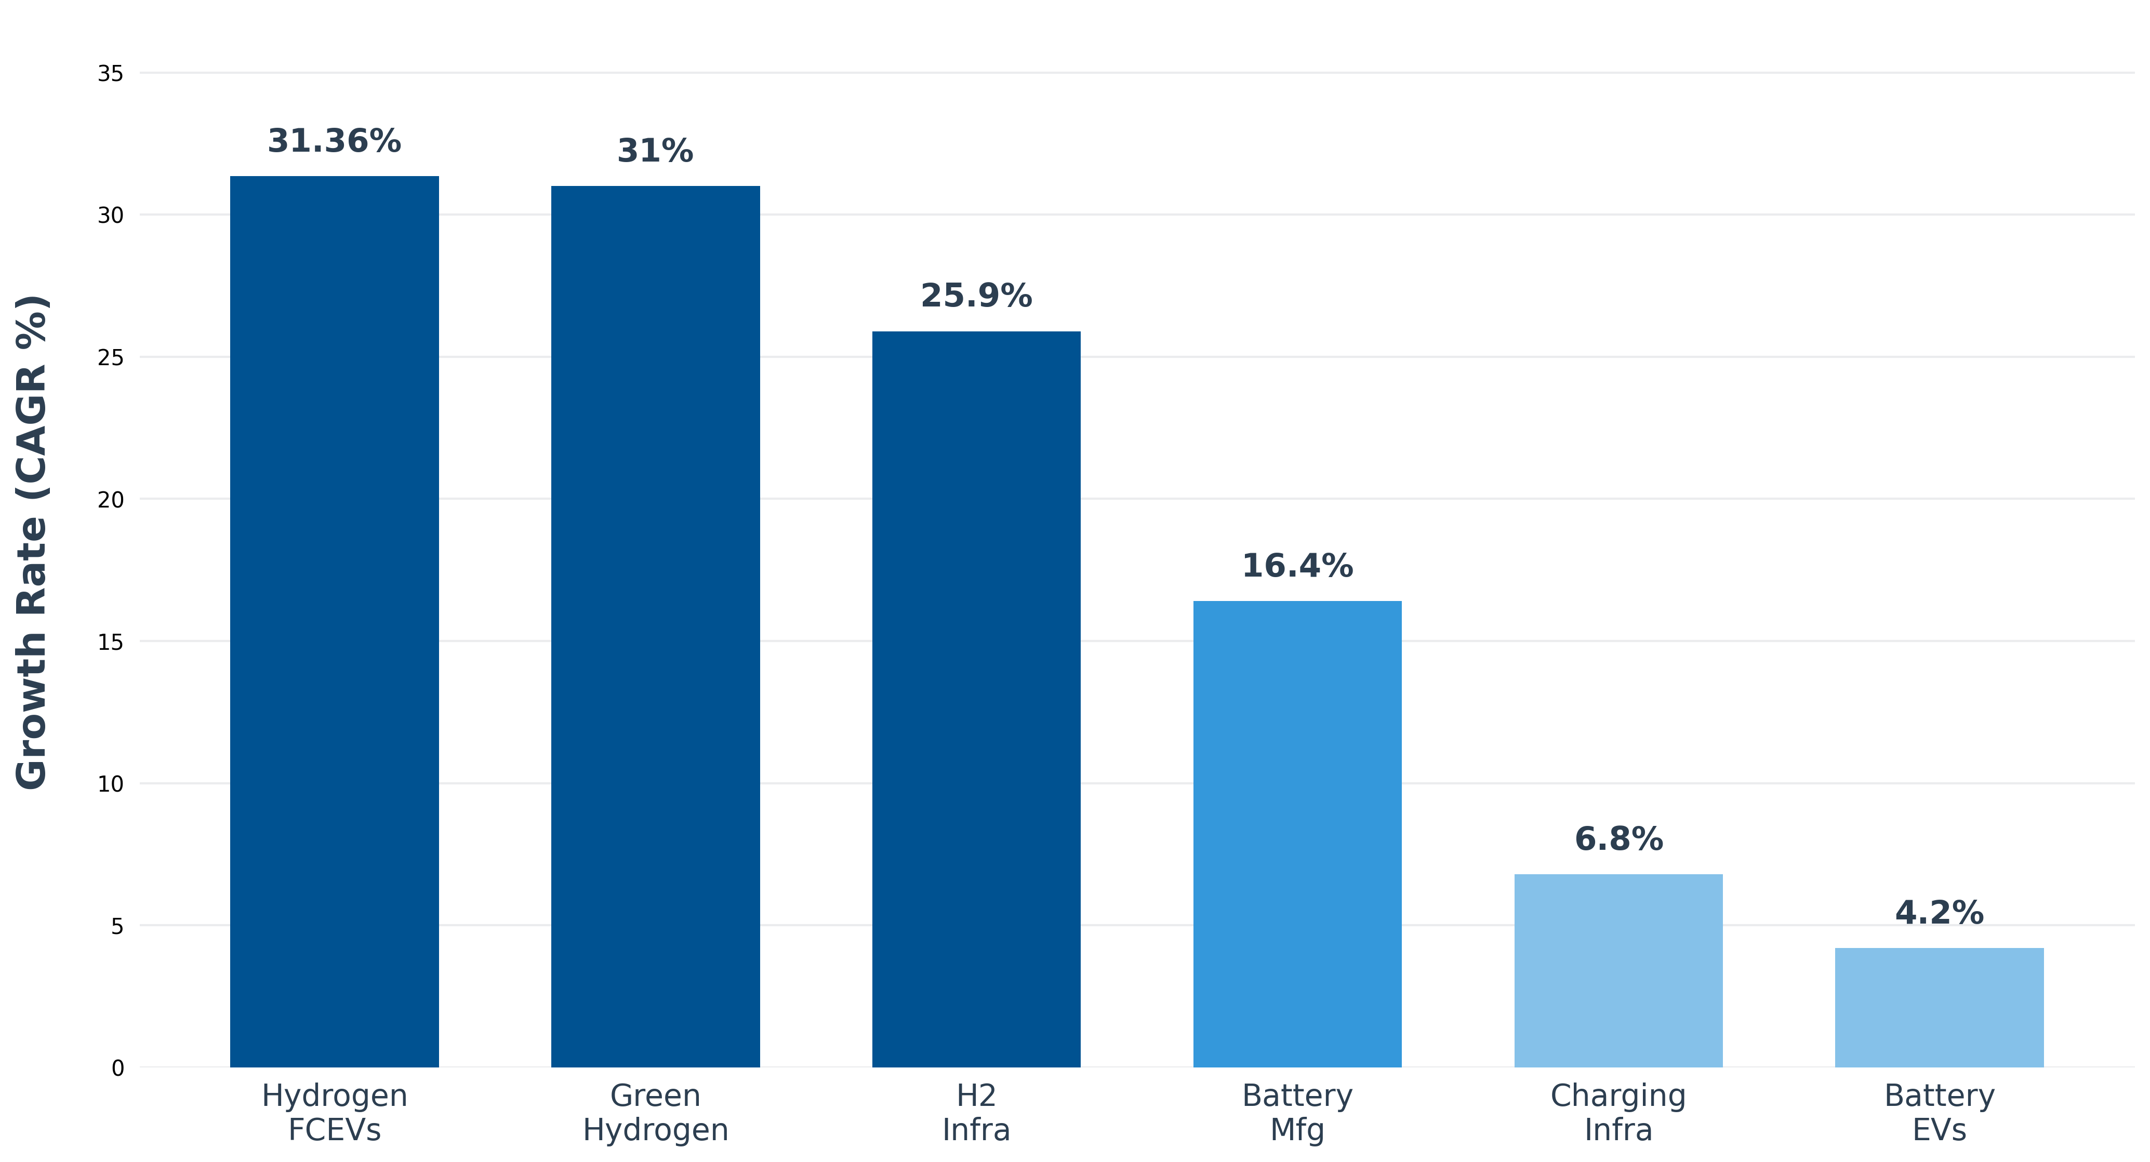
Technology Growth Momentum Analysis (CAGR %)
Hydrogen technologies outpacing battery solutions 2:1
Source: Univdatos (2024), Cognitive Market Research (2024)

Slide 5
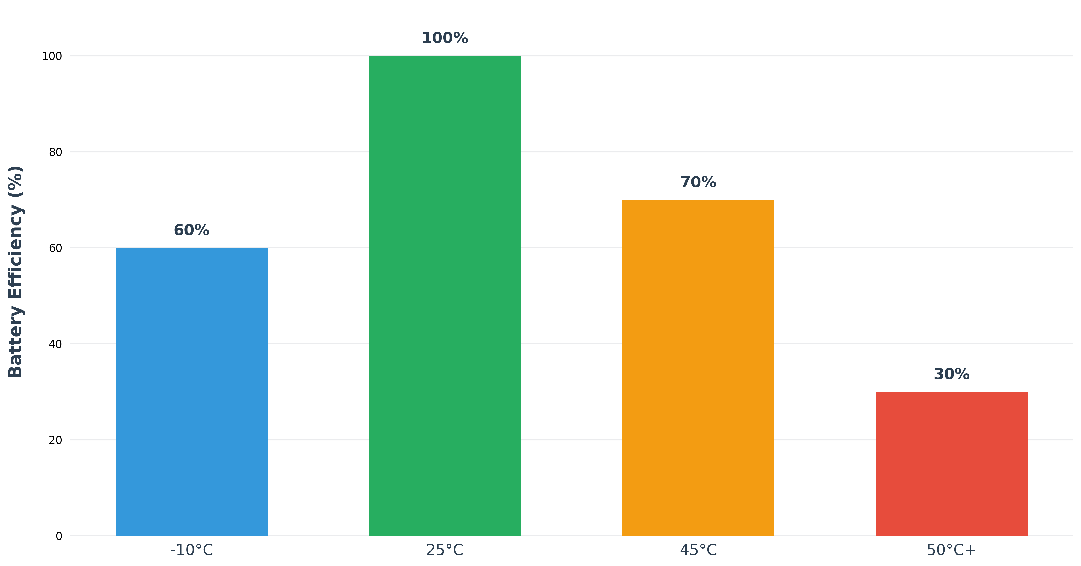
Battery Performance Degradation in Extreme Heat
Desert temperatures severely impact battery efficiency
Source: PwC Middle East (2024), Technical analysis

Slide 6
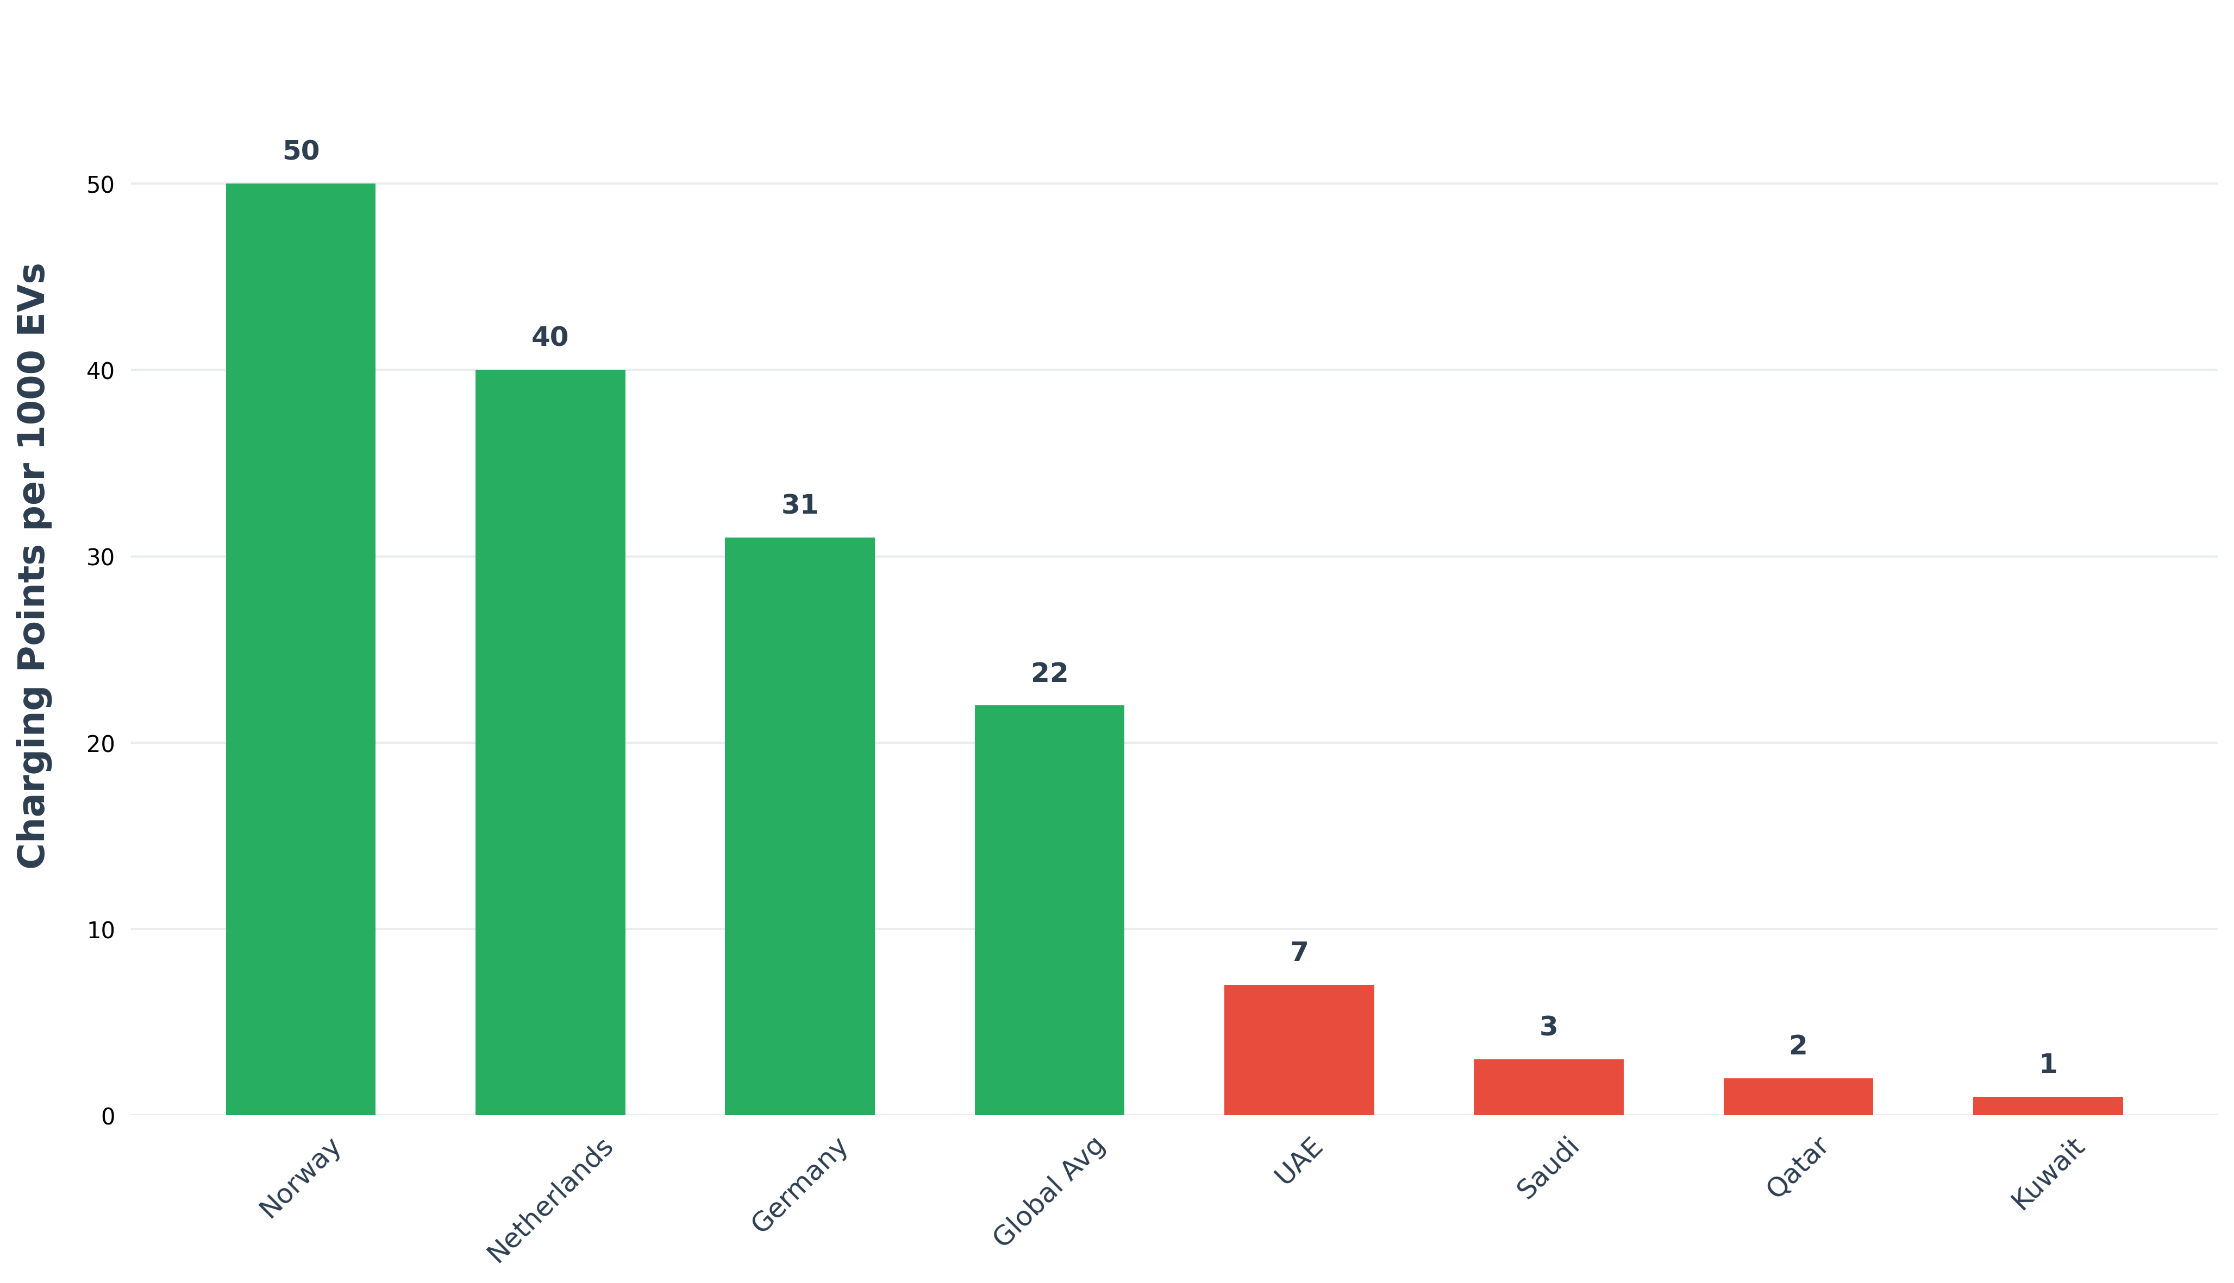
EV Infrastructure Gap Analysis (Charging Points per 1000 EVs)
Middle East infrastructure requires 7x capacity increase
Source: Roland Berger (2024), Regional analysis

Slide 7
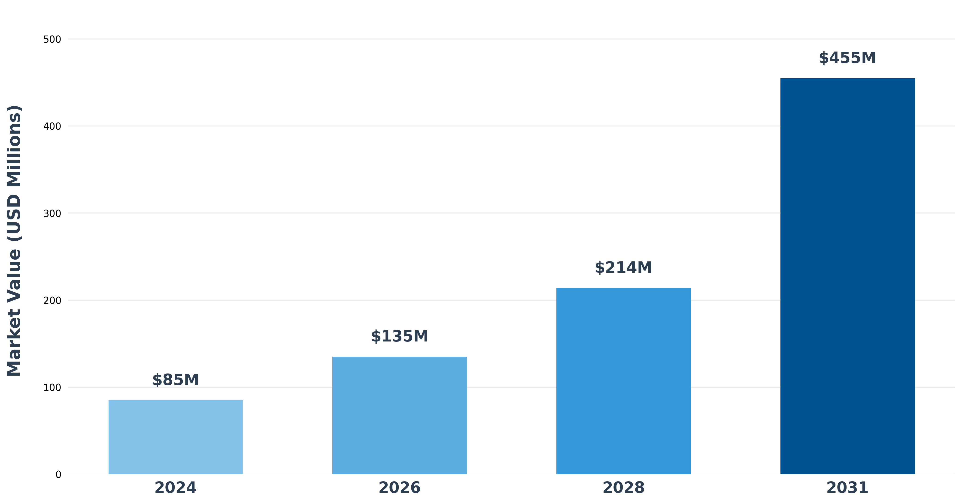
Hydrogen Market Growth Trajectory: 435% Expansion
Exceptional 7-year growth from $85M to $455M
Source: Cognitive Market Research (2024)

Slide 8
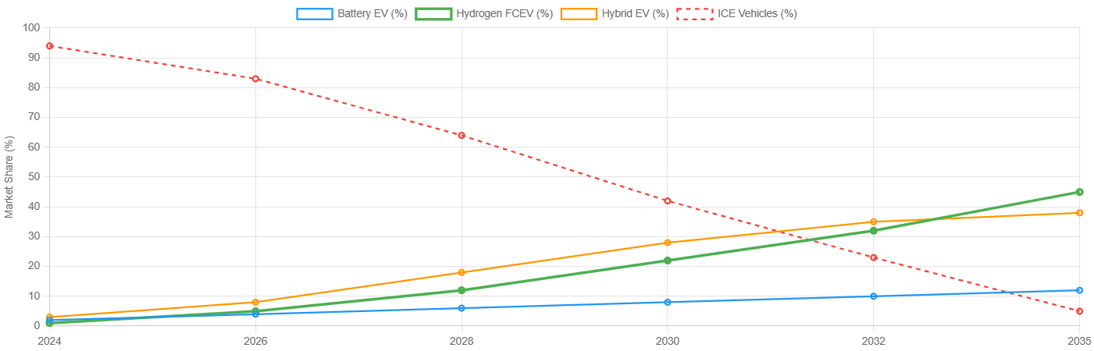
Middle East Sustainable Vehicle Technology Roadmap
Key insight: Hybrid Resurgence (HFCEV + HEV) reaching 83% by 2035, while traditional Electrification Surge (BEV) plateaus at just 12%. This projection reflects superior technology-climate fit and infrastructure advantages.

Slide 9
Strategic Barriers: Why EVs Struggle in the Middle East
Extreme Climate Impact
Consumer Preference Gap
Infrastructure Capacity Gap
50°C+ sustained temperatures create critical performance degradation for battery systems
78% market preference for large SUVs with limited EV options in luxury segments
Current 1:73 charging ratio vs. required 1:10 standard represents massive shortfall
Economic Disincentives
Range Anxiety Factors
Grid Stability Concerns
Fuel subsidies keep gasoline 60-80% below global averages, eliminating EV cost advantage
Vast intercity distances (400-600km) with limited charging infrastructure between cities
Peak cooling season electrical demand conflicts with charging requirements

Slide 10
Hydrogen Fuel Cell Advantages in Desert Conditions
• Climate Resilience: Maintains 95% efficiency from -30°C to +60°C with no thermal management penalties
• Rapid Refueling: 3-5 minute refueling time comparable to gasoline vehicles vs. 45+ minutes for EV charging
• Range Consistency: 300+ mile range unaffected by air conditioning usage or extreme temperatures
• Infrastructure Synergy: Existing natural gas pipelines can be repurposed for hydrogen distribution
• Weight Advantage: Fuel cell systems 10-15% lighter than equivalent battery systems
• Lifecycle Benefits: Minimal temperature impact on fuel cell degradation vs. 35-50% battery lifecycle reduction

Slide 11
Economic Impact and Investment Analysis
• Total Cost of Ownership (5-year): Gasoline SUV $65K | Battery EV $88K | Hydrogen FCEV $98K
• Infrastructure Investment Requirements: Hydrogen $70B vs. Battery $115-145B (40-50% savings)
• Job Creation Potential: 120,000+ direct positions across manufacturing, infrastructure, and export sectors
• GDP Contribution: Hydrogen economy projected $25-40B regional contribution by 2035
• Export Market Development: International hydrogen demand growing 35% annually creates export opportunities
• Energy Security Enhancement: Diversified fuel sources reducing petroleum dependency by 35-45%

Slide 12
Regional Hydrogen Strategy Implementation
UAE Leadership
Saudi Vision 2030
Qatar World Cup Legacy
USD 15B allocated to green hydrogen facilities | Japan/South Korea partnerships for FCEV technology transfer
NEOM project: world's largest green hydrogen facility | Aramco hydrogen vehicle pilot programs
Hydrogen refueling stations integrated with transport hubs | Commercial fleet conversion programs
Technology Performance Matrix: Desert Operations
Hydrogen FCEV
Battery EV
ICE Baseline
Range: 95% retention | Refuel: 5 min | Heat: Excellent | Maintenance: Minimal | Weight: Optimal
Range: 60% retention | Charge: 45+ min | Heat: Poor | Maintenance: Intensive | Weight: Heavy
Range: 85% retention | Refuel: 5 min | Heat: Good | Maintenance: Standard | Weight: Medium

Slide 13
Investment Returns and NPV Analysis
Hydrogen Infrastructure NPV: $13.3B over 10-year period with 25-30% IRR projections
Battery Infrastructure NPV: $200M over equivalent period with negative IRR in several scenarios
Return Multiple: Hydrogen infrastructure delivers 66x superior returns vs. battery alternatives
Payback Period: Hydrogen refueling stations 7-12 years vs. battery charging networks 12-18 years
Government Incentives: 40-60% capital cost support available for hydrogen infrastructure development
Risk Mitigation: Existing gas infrastructure repurposing reduces deployment risk by 60-70%

Slide 14
Market Segmentation: Commercial vs. Passenger Vehicles
Commercial Fleet Priority
Luxury Passenger Segment
Government Fleet Adoption
Heavy-duty trucks, buses, logistics vehicles | High utilization rates favor hydrogen refueling speed
Premium SUVs, executive vehicles | Performance expectations align with hydrogen capabilities
Public sector leadership demonstration | Policy alignment with sustainability goals
Export Market Development
Tourism Industry Applications
Industrial Applications
Hydrogen vehicle manufacturing for global markets | Technology transfer opportunities
Airport shuttles, hotel transport | High-visibility adoption showcasing technology
Port operations, mining equipment | Heavy-duty applications where batteries inadequate

Slide 15
Risk Assessment and Mitigation Strategies
• Technology Risk: Fuel cell cost reduction trajectory on track with 40-60% reductions by 2030
• Infrastructure Risk: Phased deployment approach minimizes stranded asset exposure
• Market Risk: Multiple end-user segments reduce dependency on single adoption pathway
• Regulatory Risk: Government alignment with hydrogen strategy provides policy stability
• Competition Risk: First-mover advantage window exists for 2024-2026 market entry
• Financial Risk: Diversified funding sources including sovereign wealth, private equity, and development banks

Slide 16



Strategic Implementation Roadmap: 2024-2035
Foundation Phase (2024-2026)
Maturity Phase (2031-2035)
Regulatory framework | Safety standards | Initial refueling stations | Pilot fleet programs
Market leadership | Full ecosystem | International exports | Technology innovation hub
Growth Phase (2027-2030)
Network expansion | Commercial adoption | Manufacturing partnerships | Export preparation

Slide 17
Stakeholder Recommendations: Action Framework
Government Strategy
Investment Strategy
Manufacturing Strategy
Establish hydrogen safety standards | Prioritize refueling infrastructure | Realign incentives toward fuel cells
Target production facilities | Develop refueling networks | Partner with commercial fleet operators
Focus on commercial/luxury segments | Adapt for extreme climates | Build local partnerships
Energy Company Strategy
Fleet Operator Strategy
Financial Institution Strategy
Repurpose gas infrastructure | Develop green hydrogen production | Create export capabilities
Pilot hydrogen vehicle programs | Assess operational benefits | Scale based on performance
Structure hydrogen infrastructure debt | Develop project finance expertise | Support ecosystem development

Slide 18
Financial Projections: The Business Case for Hydrogen
• Market Size Evolution: $85M (2024) → $135M (2026) → $214M (2028) → $455M (2031)
• Revenue Streams: Vehicle sales, refueling operations, maintenance services, hydrogen production, exports
• CAPEX Requirements: $70B total infrastructure investment spread over 10-year deployment period
• OPEX Projections: 40-50% lower operational costs vs. equivalent battery infrastructure
• Break-even Analysis: Individual stations profitable by year 5-7 with 15-20% utilization rates
• Export Potential: $15-25B annual revenue opportunity by 2030 from international hydrogen demand

Slide 19
The Hydrogen Imperative
The Middle East faces a strategic choice: lead the hydrogen revolution or follow through battery compromise. With 31.36% growth rates, superior desert performance, and $455M market opportunity, hydrogen represents the optimal path to sustainable mobility leadership.

Slide 20
Sources and References
• Roland Berger (2024) - EV Charging Index: Middle East Expert Insights
• IEA Global EV Outlook (2025) - Trends in Electric Car Markets
• Cognitive Market Research (2024) - Middle East Hydrogen Fuel Cell Market Analysis
• PwC Middle East (2024) - eMobility Outlook UAE Edition
• Univdatos (2024) - Middle East Hydrogen FCEV Market Growth Projections
• Alternative Fuels Data Center (2024) - U.S. Department of Energy
• Bain & Company (2024) - Middle East Electric Vehicle Readiness Assessment
• Rest of World (2025) - UAE EV Leadership Analysis
• Fuel Cells Works (2024) - Oman-China Hydrogen MoU
• IMARC Group (2024) - Middle East Fuel Cell Market Forecast
Analysis Period: 2024-2031 with projections to 2035 | Geographic Scope: UAE, Saudi Arabia, Qatar, Kuwait, Oman, Bahrain | Methodology: Market analysis, technology assessment, economic modeling

